Slide 1


Using Monte-Carlo simulations for modeling the Coronavirus Disease (COVID-19)
Hilla De-Leon (ECT*, INFN-TIPFA),
Francesco Pederiva (UNIT, INFN-TIPFA)

Slide 2
The Monte-Carlo algorithm
The Monte-Carlo (MC) algorithm is based on transforming integrals into sums of functions evaluated on samples (usually called “walkers”) of some distribution.
The absence of truncations or uncontrolled approximations makes MC a powerful ab-initio method that can perform reliable integration of complex many-body systems and complex interactions.

Slide 3
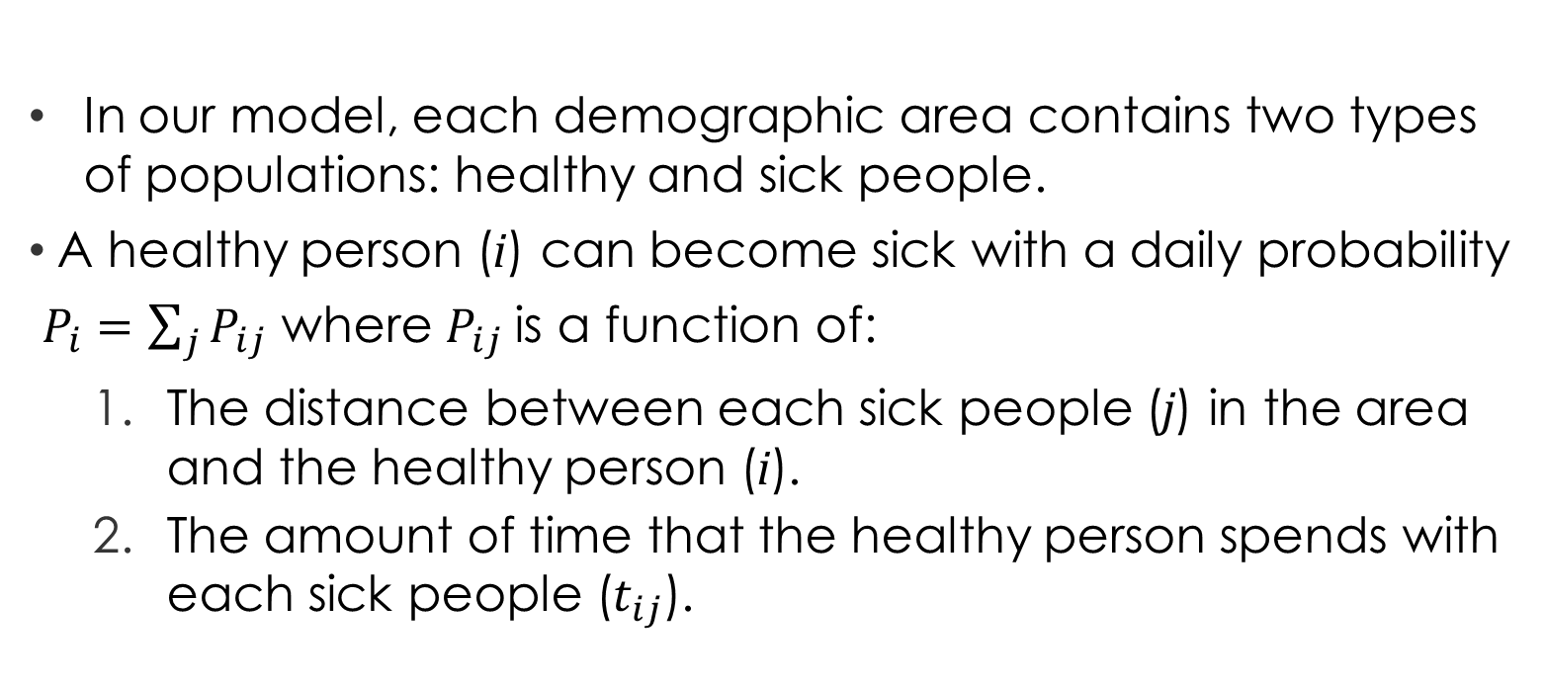
The Monte-Carlo algorithm
In our model, each demographic area contains two types of populations: healthy and sick people.
A healthy person (i) can become sick with a daily probability
$P_{i}=\sum_{j}{P_{ij}}$ where $P_{ij}$is a function of:
The distance between each sick people (j) in the area and the healthy person (i).
The amount of time that the healthy person spends with each sick people ($t_{ij}$).

Slide 4
The Monte-Carlo algorithm
We are using a “one-way” Ising-model Monte Carlo: A healthy person become sick as a result of an interaction with sick person (or people), but a sick person stops being sick (i.e. recovered or died) within an average time of ~14 up to 40 days for the severs cases.
After that time, the recovered person cannot infect another person anymore.
We repeat this simulation
The epidemiology data is based on:
eLife 2020;9:e57309 DOI: 10.7554/eLife.57309

Slide 5
The parameters and Preliminary assumptions:
Unfortunately, currently there's still a lot of unknowns regarding the spread of the novel Coronavirus, therefore we had to take some assumptions based on the current data, which may be more stringent than the real nature of the virus.
In our work we modeled the spread of the Coronavirus by running many MC simulations using the following parameters:
The epidemiology data is based on:
eLife 2020;9:e57309 DOI: 10.7554/eLife.57309

Slide 6
The parameters and Preliminary assumptions:
For all simulations, we used an area of 1 squared-km (with periodic boundary conditions, which allow us to treat this area as a bulk) with different population density.
The population density is a function of the number of households in a certain area (rather than the number of people), since it is almost impossible to prevent contagion in the family.

Slide 7
The parameters and Preliminary assumptions:
The population density is an “effective” density which represents not only the number of families in a certain area, but also the “kinetic energy (or temperature)” of the population .
For example, a nursing home with a common dining area is denser than the ones where all the residents eat in their rooms, and a neighborhood with many young families (which meet in the playground etc.) is denser than the same neighborhood with less social activities.
The epidemiology data is based on:
eLife 2020;9:e57309 DOI: 10.7554/eLife.57309

Slide 8
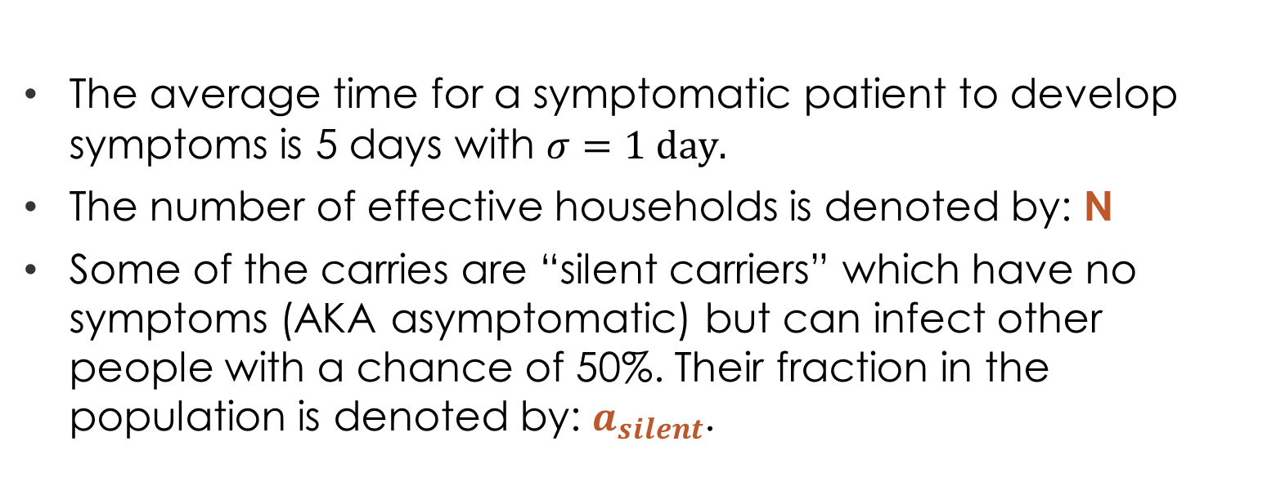
The parameters and Preliminary assumptions:
The average time for a symptomatic patient to develop symptoms is 5 days with $σ=1 day.$
The number of effective households is denoted by: N
Some of the carries are “silent carriers” which have no symptoms (AKA asymptomatic) but can infect other people with a chance of 50%. Their fraction in the population is denoted by: $a_{silent}$.
The epidemiology data is based on:
eLife 2020;9:e57309 DOI: 10.7554/eLife.57309

Slide 9
The parameters and Preliminary assumptions:
In day 0 there is only one sick person: patient_zero
In some of the models we have infections from an unknown sources (a health person can become sick without an interaction with a known sick person).
In the first 14 days the population without symptoms walks freely without any restrictions.
For each sick person, the infection period is between the 3th day to the 7th day.
The epidemiology data is based on:
eLife 2020;9:e57309 DOI: 10.7554/eLife.57309

Slide 10
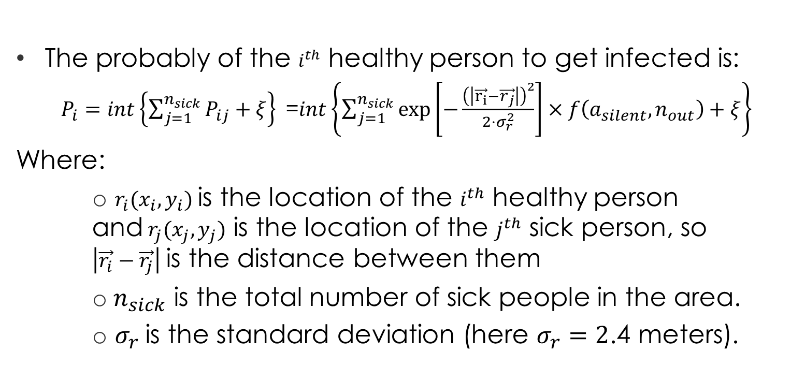
The parameters and Preliminary assumptions:
The probably of the $i^{th}$ healthy person to get infected is:
$P_{i}=int\left\{\sum_{j=1}^{n_{sick}}{P_{ij}}+ξ\right\}$=$int\left\{\sum_{j=1}^{n_{sick}}{\exp\left[−\frac{{\left(\left|\vec{r_{i}}−\vec{r_{j}}\right|\right)}^{2}}{2⋅σ_{r}^{2}}\right]}×f\left(a_{silent},n_{out}\right)+ξ\right\}$
Where:
$r_{i}(x_{i},y_{i})$ is the location of the $i^{th}$ healthy person and${ r}_{j}(x_{j},y_{j})$ is the location of the $j^{th}$ sick person, so $\left|\vec{r_{i}}−\vec{r_{j}}\right|$is the distance between them
${ n}_{sick}$ is the total number of sick people in the area.
$σ_{r}$is the standard deviation (here $σ_{r}=2$.4 meters).

Slide 11
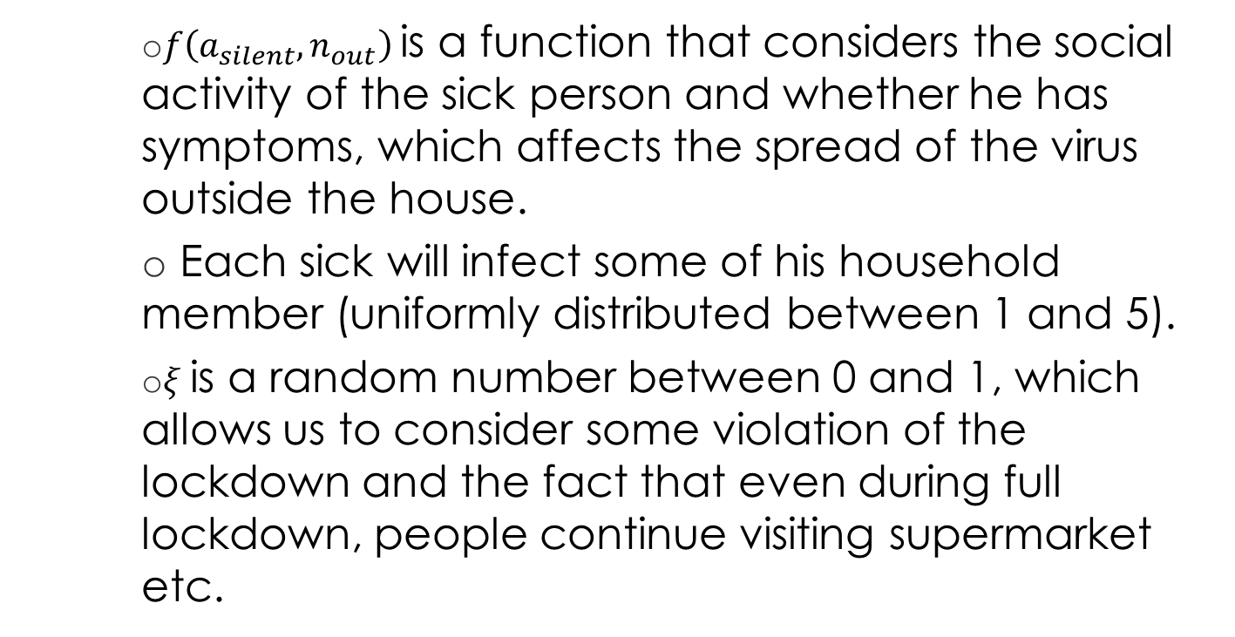
The parameters and Preliminary assumptions:
$f\left(a_{silent},n_{out}\right)$ is a function that considers the social activity of the sick person and whether he has symptoms, which affects the spread of the virus outside the house.
Each sick will infect some of his household member (uniformly distributed between 1 and 5).
$ξ$is a random number between 0 and 1, which allows us to consider some violation of the lockdown and the fact that even during full lockdown, people continue visiting supermarket etc.

Slide 12
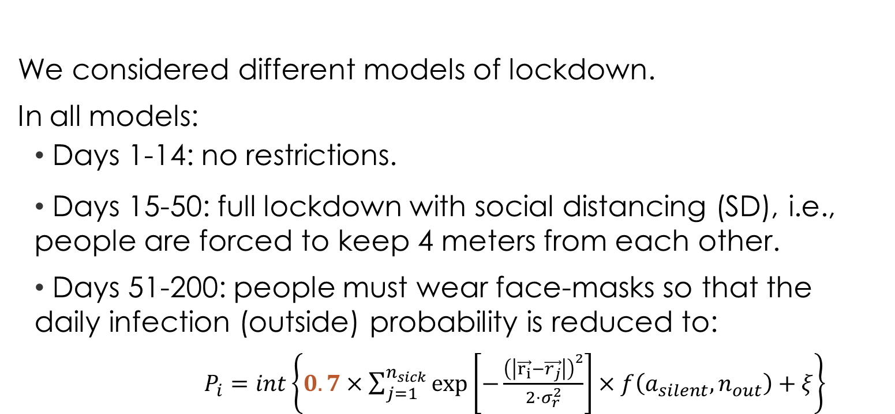
Different models of lockdown:
We considered different models of lockdown.
In all models:
Days 1-14: no restrictions.
Days 15-50: full lockdown with social distancing (SD), i.e., people are forced to keep 4 meters from each other.
Days 51-200: people must wear face-masks so that the daily infection (outside) probability is reduced to:
$P_{i}=int\left\{0.7×\sum_{j=1}^{n_{sick}}{\exp\left[−\frac{{\left(\left|\vec{r_{i}}−\vec{r_{j}}\right|\right)}^{2}}{2⋅σ_{r}^{2}}\right]}×f\left(a_{silent},n_{out}\right)+ξ\right\}$

Slide 13
Different models of lockdown:
Model #1: Days 51-200: no restrictions.
Model #2: Days 51-200: two weeks with no restrictions and then two weeks with full lockdown and so on.
Model #3: Days 51-200: one week with no restrictions and then one week with full lockdown and so on.
Model #4: Days 51-200: one week with no restrictions and then two weeks with full lockdown.
Each model was tested with and without SD on days 51-200

Slide 14
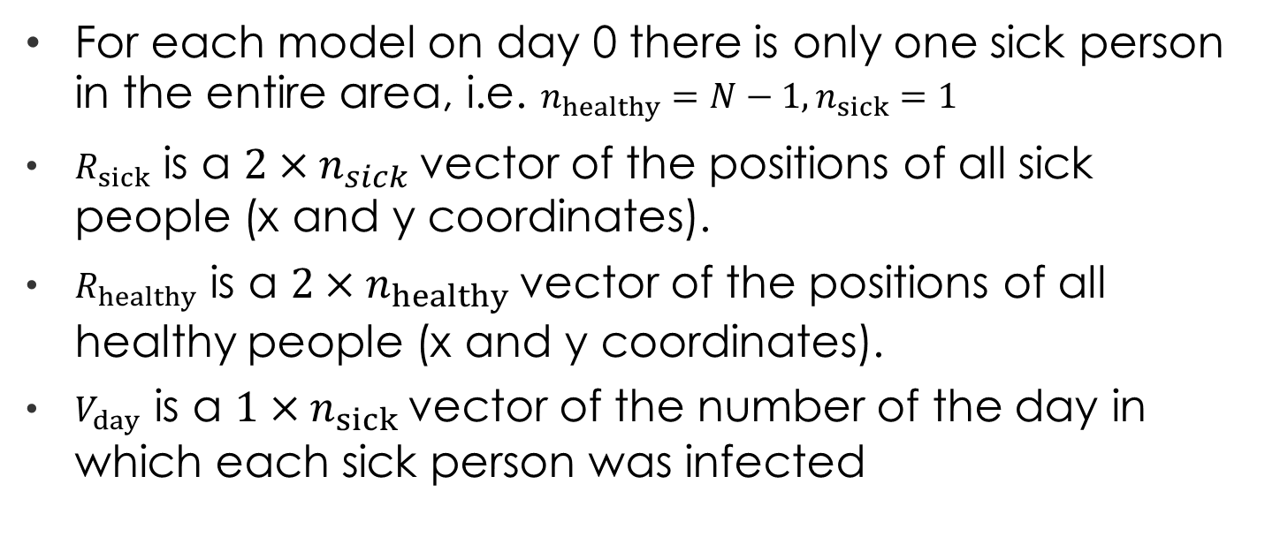
The algorithm
For each model on day 0 there is only one sick person in the entire area, i.e. $n_{healthy}=N−1, n_{sick}=1$
$R_{sick}$ is a $2×n_{sick}$vector of the positions of all sick people (x and y coordinates).
$R_{healthy}$ is a $2×n_{healthy}$vector of the positions of all healthy people (x and y coordinates).
$V_{day}$ is a $1×n_{sick}$vector of the number of the day in which each sick person was infected

Slide 15
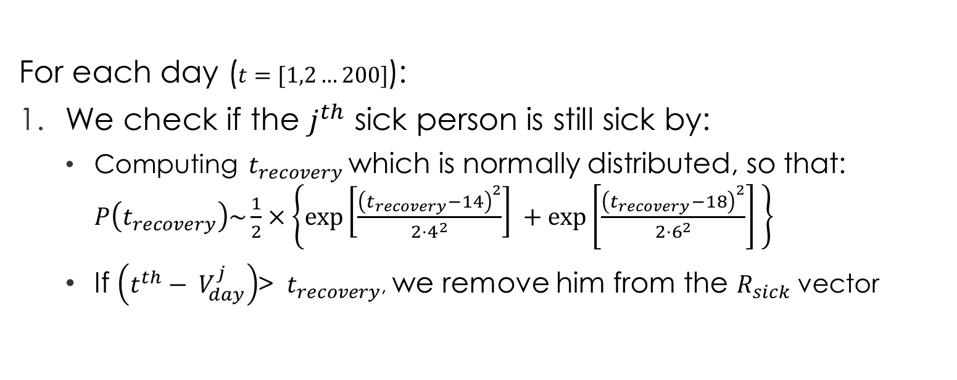
The algorithm
For each day ($t=[1,2…200]$):
We check if the $j^{th}$ sick person is still sick by:
Computing ${ t}_{recovery}$which is normally distributed, so that: $P\left(t_{recovery}\right)\sim \frac{1}{2}×\left\{\exp\left[\frac{{\left(t_{recovery}−14\right)}^{2}}{2⋅4^{2}}\right] +\exp\left[\frac{{\left(t_{recovery}−18\right)}^{2}}{2⋅6^{2}}\right] \right\}$
If $\left(t^{th}− V_{day}^{j}\right)$> ${ t}_{recovery}$, we remove him from the $R_{sick}$ vector

Slide 16
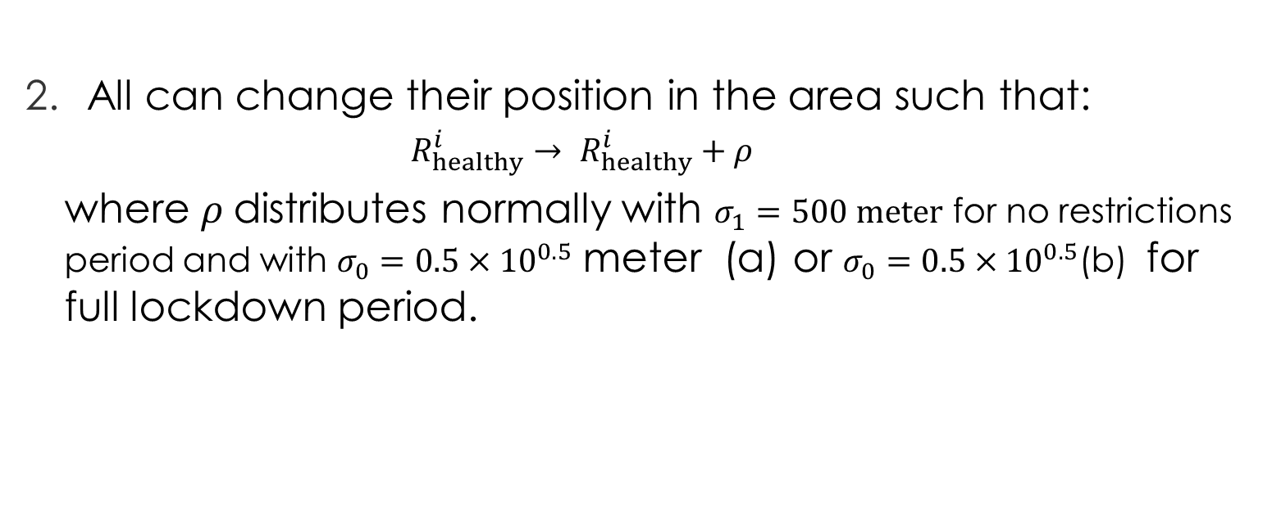
The algorithm
All can change their position in the area such that:
$$R_{healthy}^{i}→ R_{healthy}^{i}+ρ$$
where $ρ$distributes normally with $σ_{1}=500 meter$ for no restrictions period and with $σ_{0}=0.5×{10}^{0.5}$ meter (a) or $σ_{0}=0.5×{10}^{0.5}$(b) for full lockdown period.

Slide 17
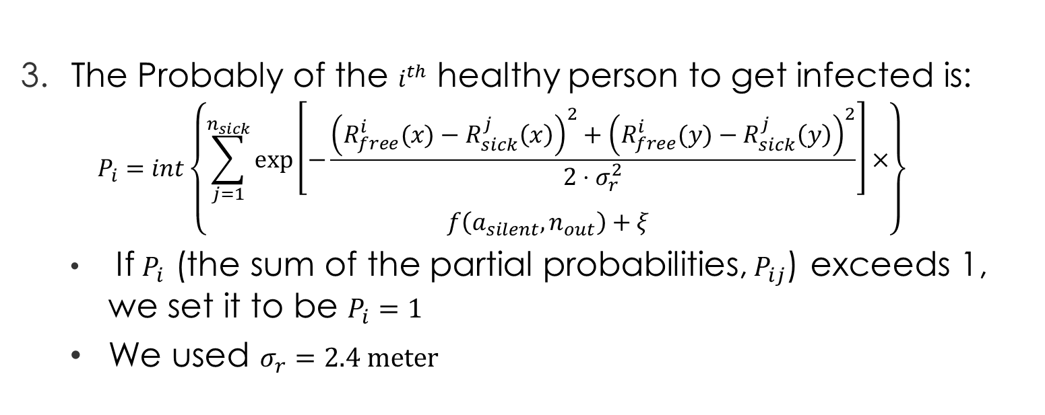
The algorithm
The Probably of the $i^{th}$ healthy person to get infected is:
$$P_{i}=int\left\{\begin{aligned}\sum_{j=1}^{n_{sick}}{\exp\left[−\frac{{\left(R_{free}^{i}(x)−R_{sick}^{j}\left(x\right)\right)}^{2}+{\left(R_{free}^{i}(y)−R_{sick}^{j}\left(y\right)\right)}^{2}}{2⋅σ_{r}^{2}}\right]}× \\ f\left(a_{silent},n_{out}\right)+ξ\end{aligned}\right\}$$
If $P_{i}$ (the sum of the partial probabilities,${ P}_{ij}$) exceeds 1, we set it to be $P_{i}=1$
We used $σ_{r}=2.4 meter$

Slide 18
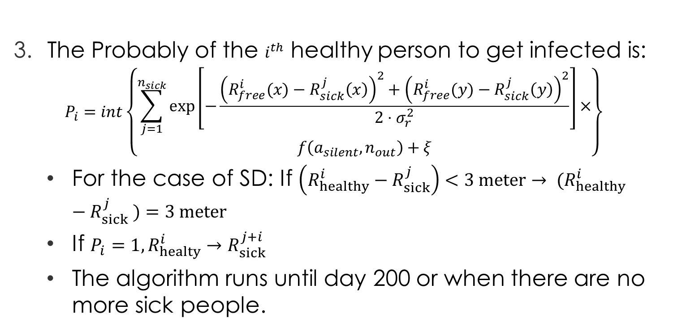
The algorithm
The Probably of the $i^{th}$ healthy person to get infected is:
$$P_{i}=int\left\{\begin{aligned}\sum_{j=1}^{n_{sick}}{\exp\left[−\frac{{\left(R_{free}^{i}(x)−R_{sick}^{j}\left(x\right)\right)}^{2}+{\left(R_{free}^{i}(y)−R_{sick}^{j}\left(y\right)\right)}^{2}}{2⋅σ_{r}^{2}}\right]}× \\ f\left(a_{silent},n_{out}\right)+ξ\end{aligned}\right\}$$
For the case of SD: If $\left(R_{healthy}^{i}−R_{sick}^{j}\right)<3 meter→ (R_{healthy}^{i}−R_{sick}^{j} )=3 meter$
If $P_{i}=1, R_{healty}^{i}→R_{sick}^{j+i}$
The algorithm runs until day 200 or when there are no more sick people.

Slide 19
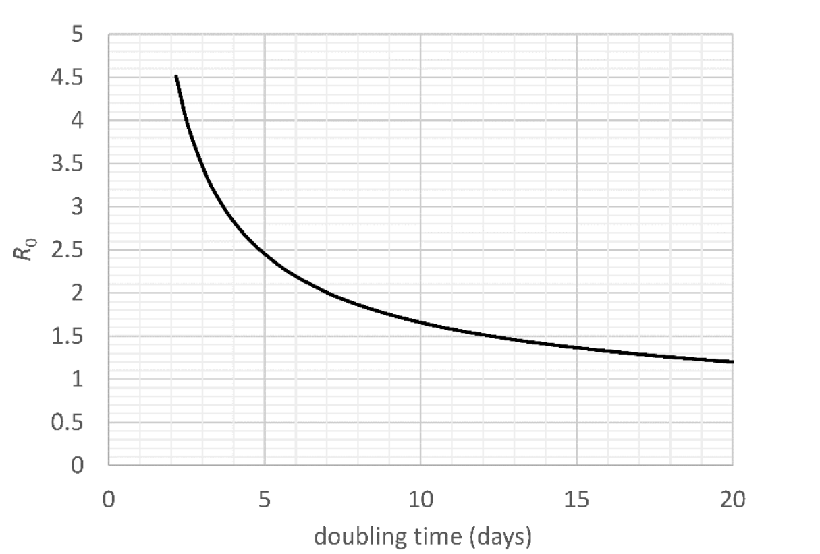
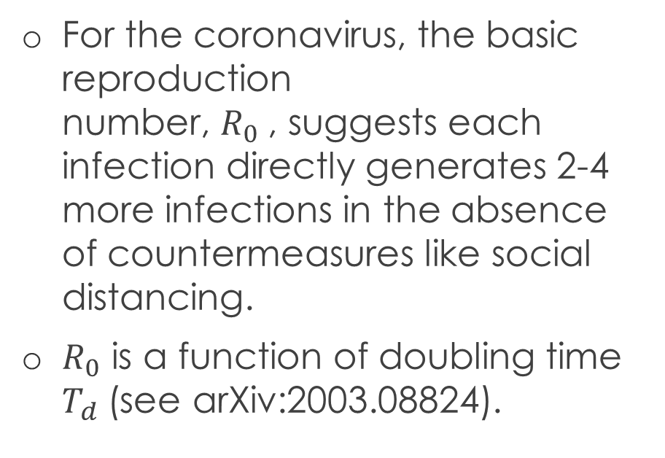
Basic reproduction number
For the coronavirus, the basic reproduction number, $R_{0}$​, suggests each infection directly generates 2-4 more infections in the absence of countermeasures like social distancing.
$R_{0}$ is a function of doubling time $T_{d}$(see arXiv:2003.08824).
The epidemiology data is based on:
eLife 2020;9:e57309 DOI: 10.7554/eLife.57309

Slide 20
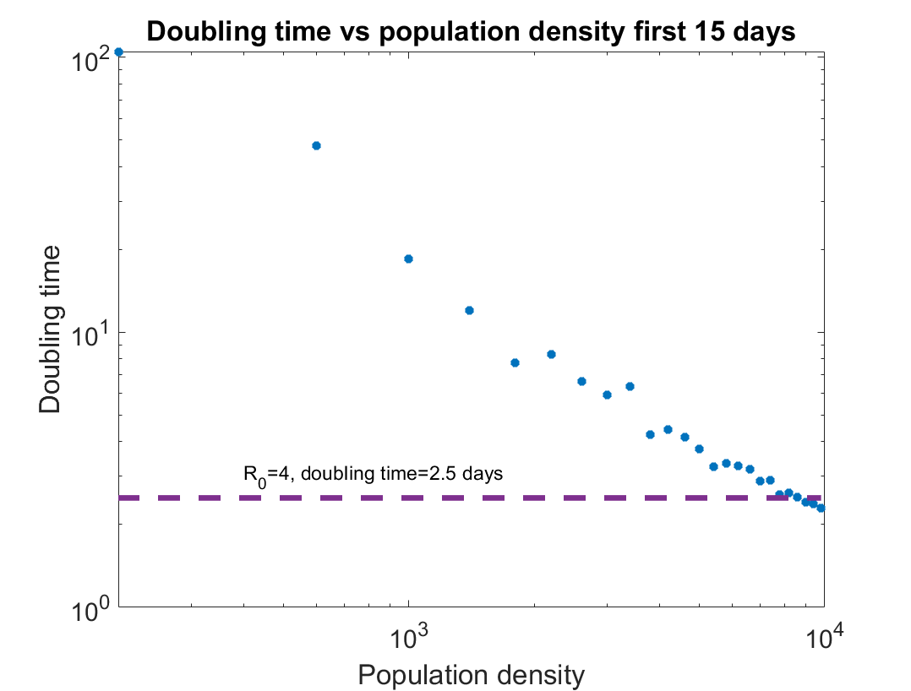


Results: doubling time vs population density
$$doubling time [days]$$
$$population density$$

Slide 21
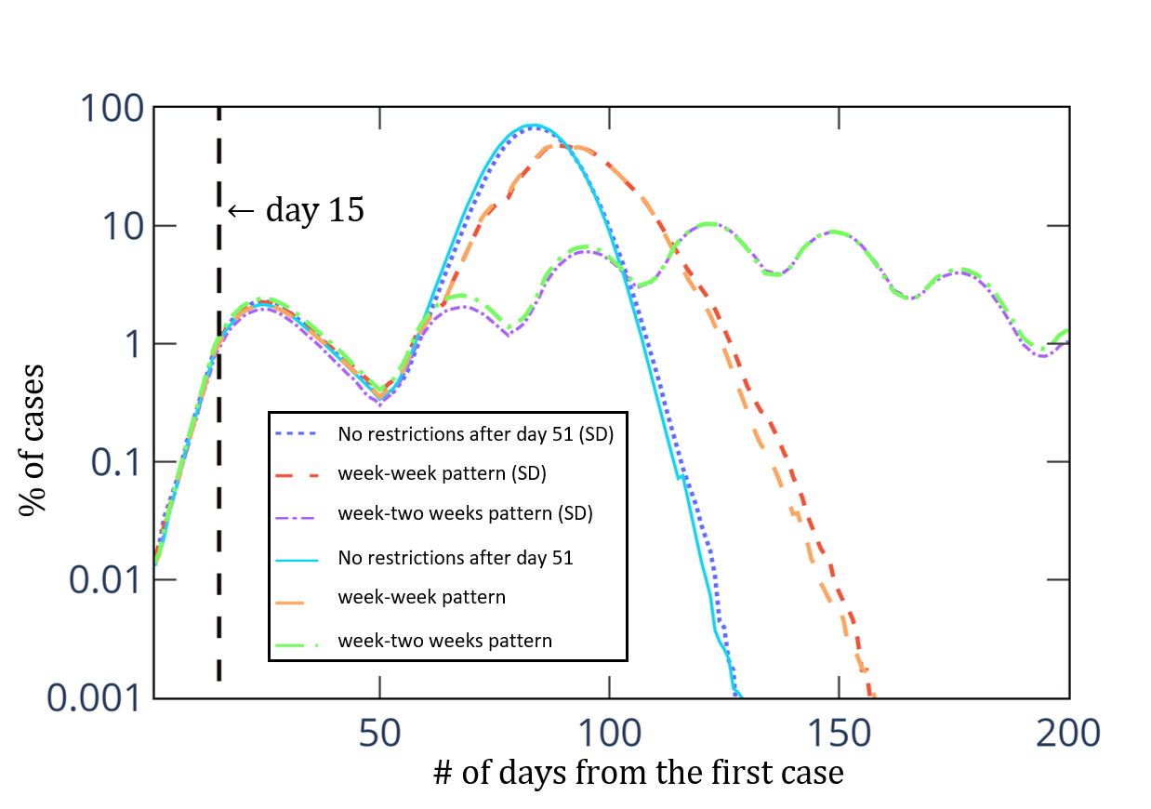

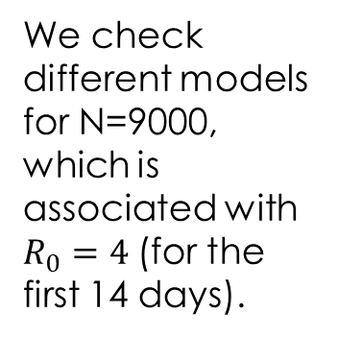
Results:${ R}_{0}(1−15)=4$
We check different models for N=9000, which is associated with $R_{0}=4$(for the first 14 days).
Without infections from an unknown sources

Slide 22
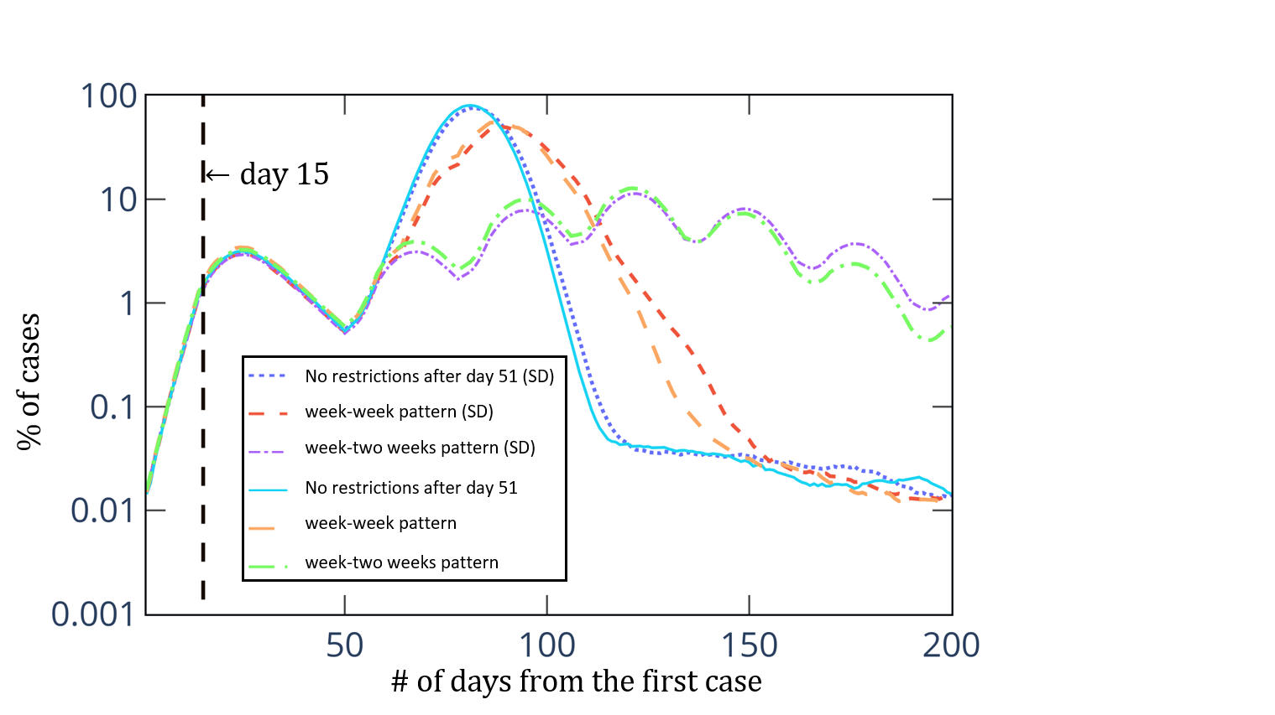
Results:${ R}_{0}(1−15)=4$
We check different models for N=9000, which is associated with $R_{0}=4$(for the first 14 days).
With infections from an unknown sources

Slide 23
Results:${ R}_{0}(1−15)=4$
We check different models for N=9000, which is associated with $R_{0}=4$(for the first 14 days).
With infections from an unknown sources

Slide 24
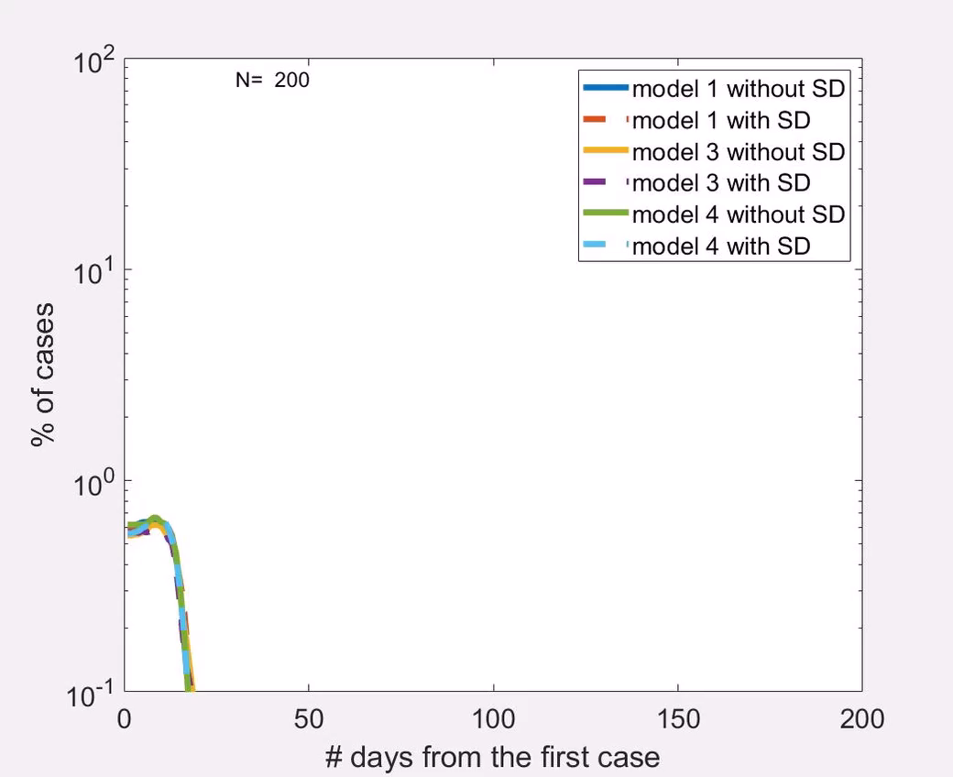

Results: all${ R}_{0}$
Without infections from an unknown sources

Slide 25
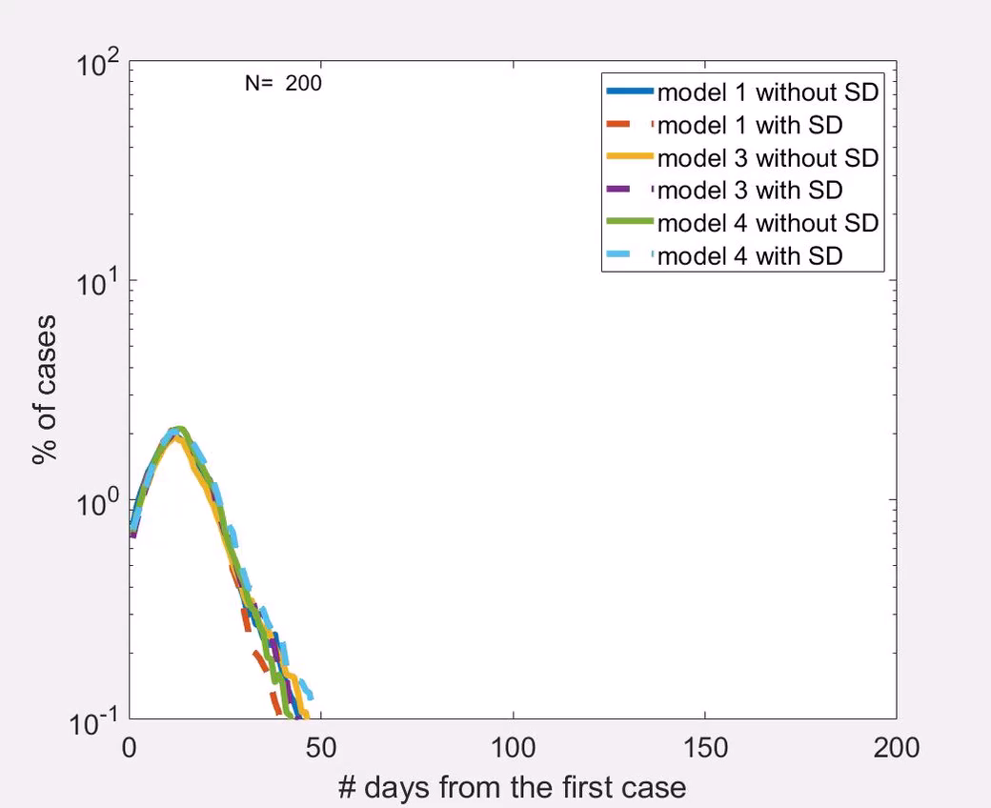
Results: all${ R}_{0}$
With infections from an unknown sources

Slide 26
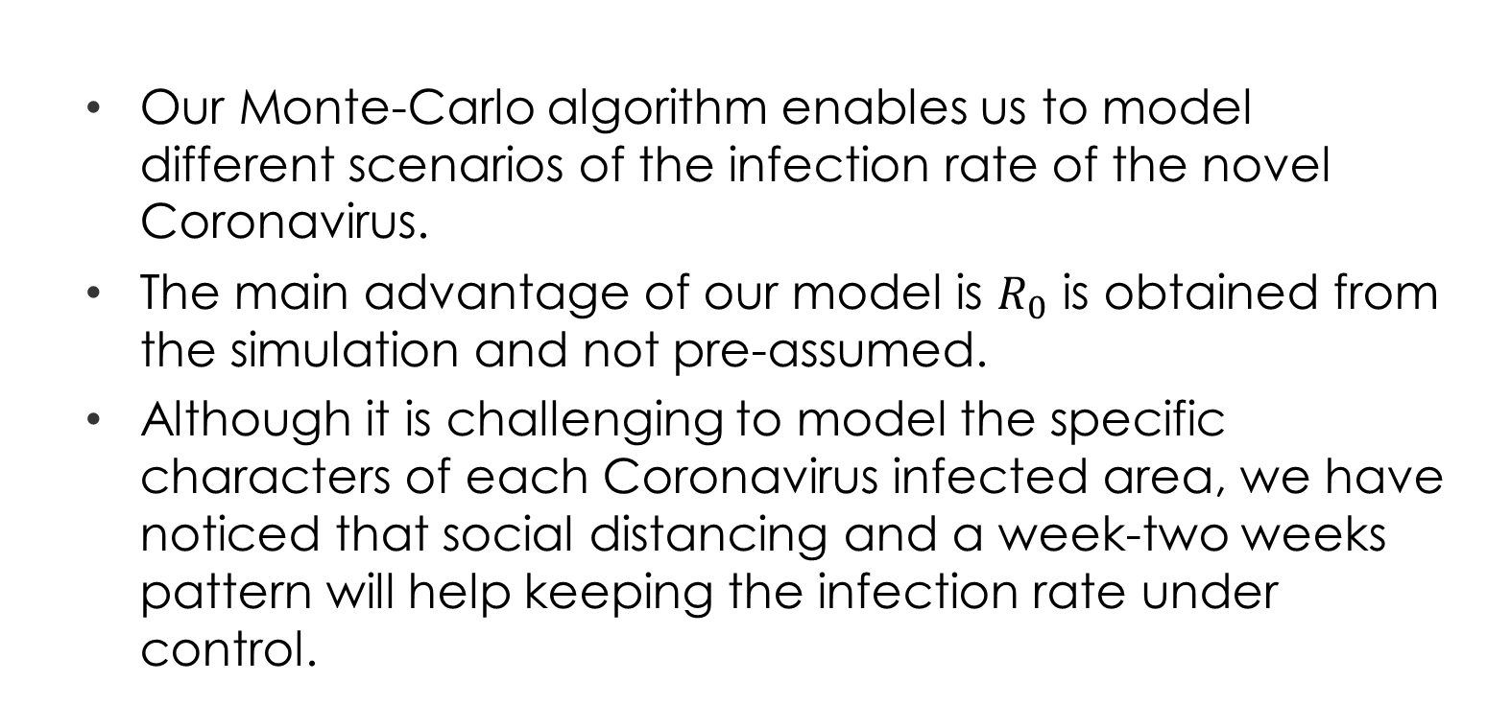
Discussion and conclusions
Our Monte-Carlo algorithm enables us to model different scenarios of the infection rate of the novel Coronavirus.
The main advantage of our model is $R_{0}$ is obtained from the simulation and not pre-assumed.
Although it is challenging to model the specific characters of each Coronavirus infected area, we have noticed that social distancing and a week-two weeks pattern will help keeping the infection rate under control.

Slide 27
Discussion and conclusions
The main task of the decision makers is to lower the “kinetic energy” of each area as possible by keeping social distancing and minimizing the high “kinetic energy” regions.
High “kinetic energy” regions are: schools, playground, kindergartens, houses of prayer etc.

